Slide 1

2022
SOP Weekly Meeting
9/18/23

Slide 2
Agenda
Won Deals By Quarter Analysis
Q3 Delivery Status Overview
TUS Inventory Overview
Aging Inventory
Q3 Prepayment Status
Factory Availability
Logistics Updates
Weekly Shipping & Commodity Index

Slide 3
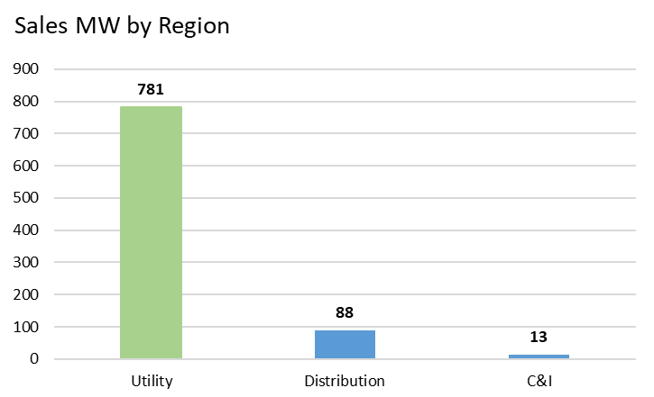
1H, 2023 Delivered Volumes Q1
Utility SOP 677MW Distribution SOP 140MW C&I SOP 38MW TP SOP 10MW

Slide 4
1H, 2023 Delivered Volumes Q2
Utility SOP 794MW C&I SOP 61MW Distribution SOP 150MW TP SOP 22MW
Region | MW
Utility | 964
C&I | 36
Distribution | 54
Grand Total | 1054

Slide 5
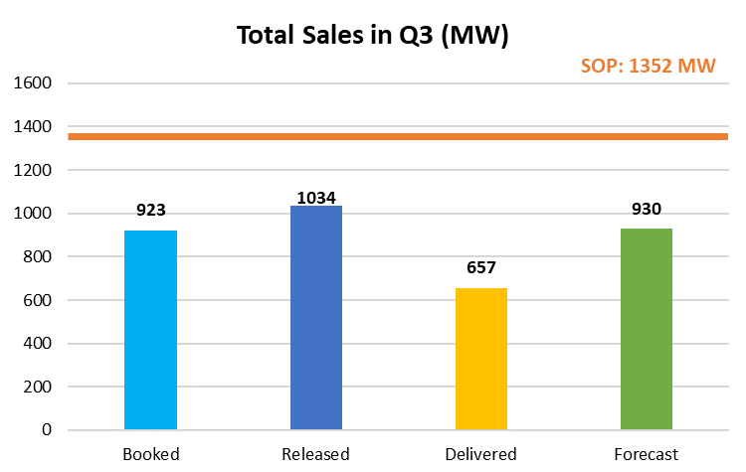
2H, 2023 Booked Volumes Q3 (BP 1.614GW); SOP Target suggested 1.352GW (Utility 964, TP 30, CI 100. Disti 257 ): GAP 429MW

Slide 6
2H, 2023 Booked Volumes Q3 (BP 1.614GW); SOP Target suggested 1.352GW GAP 429MW

Slide 7
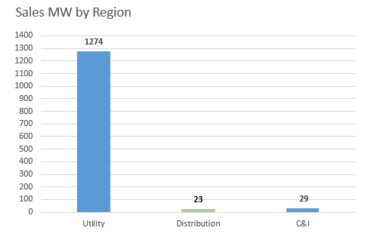
2H, 2023 Booked Volumes Q4 (Bottom Up SOP 1.5GW, BP 1.635GW)
2023 booked 4.1GW so far
AOP 5.34GW
We have 1.24GW to go
Region | MW
Utility | 1274
Distribution | 23
C&I | 29
Grand Total | 1326

Slide 8
1H, 2024 Booked Volumes Q1

Slide 9
1H, 2024 Booked Volumes Q2

Slide 10
2H, 2024 Booked Volumes Q3

Slide 11
2H, 2024 Booked Volumes Q4
Total 2024 Booked so far:
2.456GW
Drafted BP 6.44GW
(5.6GW Utility, 840 non-utility)
booked 38% of target

Slide 12
2022
TUS Inventory Overview
9/18/23

Slide 13
Total Inventory – 1817MW Booked: 1372MW, Non-Booked: 398MW, Factory Inventory: 47MW

Slide 14
Summary Overview – NA Inventory Modules
NA Inventory Modules Total MW: 1817 MW

Slide 15
Summary Overview – NA Inventory Modules
Day 303 to exceed threshold
NA Inventory Modules Total MW: 1770 MW
Threshold: 50MW
397MW/50MW: 794% (Excluding EOL products)
398
79MW out of 385MW are reserved

Slide 16
Q3 100 MW Inventory Clearance – Booked for Q3 per BU
12MW out of 100MW booked so far
All Modules (Q3 ONLY)
Total Clearance Limit | 100
Total Booked | 12
Remaining Clearance | 88
Residential Modules Only (Q3 + Q4)
Additional Clearance Limit | 100
Total Resi Booked | 0
Remaining Additional Clearance | 100

Slide 17
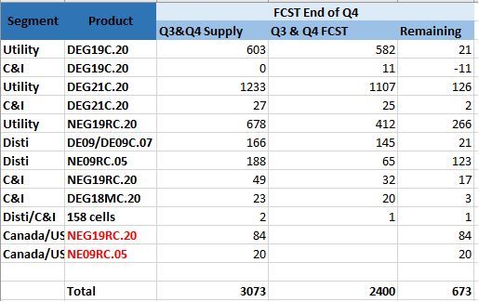
Non-Booked Inventory Simulation and Forecast
Forecast Quarter | Non-Booked Inventory
Current | 379MW
End of Q3 (Assume 1GW in Q3, booked 921MW) | 459MW
End of Q4(Assume 1.5GW in Q4, need 350MW more sales ) | 573MW
End of Q4(Assume 1.4GW in Q4, need 250MW more sales ) | 673MW

Slide 18
Summary Overview – NA Inventory Modules NA Inventory Modules Total MW: 1760 MW
***Phase out products need to be sold***

Slide 19
NA Inventory Reservations Total MW: 79MW

Slide 20
Summary Overview – NA Inventory Modules
NA Inventory Modules Total MW: 1770 MW

Slide 21
Factory Inventory – 47 MW

Slide 22
Q3 Delivery Status Overview
12 days remaining before Q3 ends
Q3 Target: 1352MW
Q3 Schedule Passed: 87%
Q3 Delivered:713/980MW = 72%
Q3 Released: 1034MW/1352MW = 76%
Q3 Supposed to be Released: 923MW/1352MW = 68%
Q3 Released (in the warehouse )but not delivered- 172MW/1034MW = 16%
69%

Slide 23
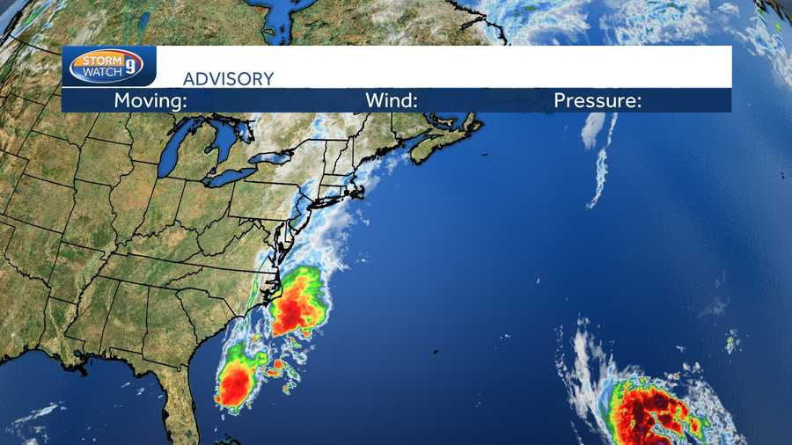
Mediology
Last Week

Slide 24
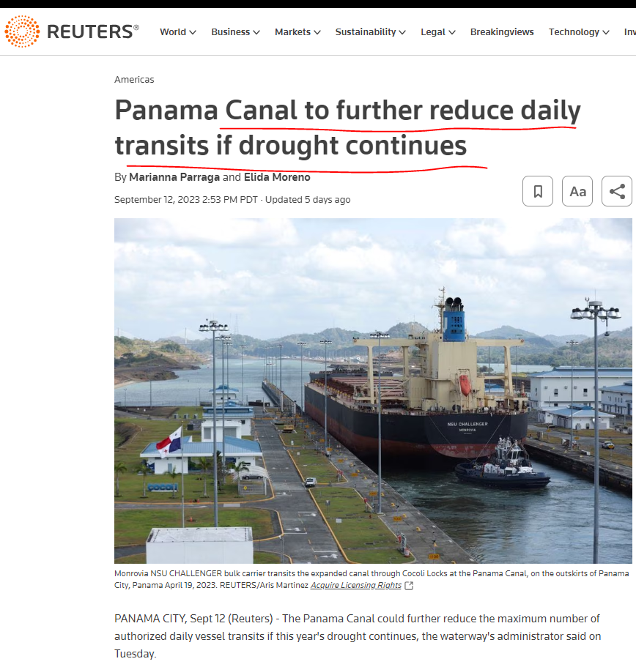
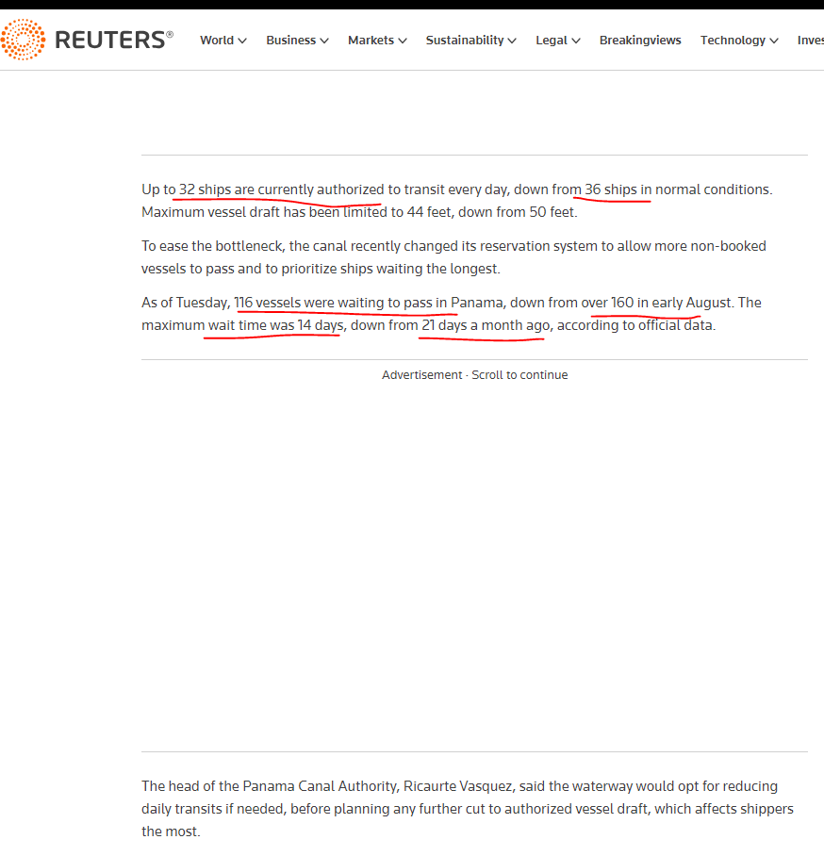
Mediology

Slide 25
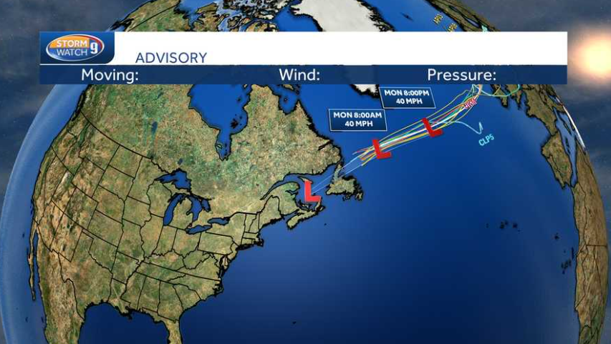
Mediology
This Week.
winds of 70 mph, just below the 74 mph threshold for a Category 1 hurricane

Slide 26
THANK YOU

